Slide 1
IOT PROTOCOLS & SECURITY
ESIOT: Unit 4

Slide 2
IEEE 802.15.4
IEEE 802.15.4 is a technical standard which defines the operation of low-rate wireless personal area networks (LR-WPANs).
The basic framework conceives a 10-meter communications range with a transfer rate of 250 kbit/s.
It specifies the physical layer and media access control for LR-WPANs, and is maintained by the IEEE 802.15 working group, which defined the standard in 2003.
It is the basis for the ZigBee specifications of which further extends the standard by developing the upper layers which are not defined in IEEE 802.15.4.
Alternatively, it can be used with 6LoWPAN, the technology used to deliver the IPv6 version of the Internet Protocol (IP) over WPANs, to define the upper layers.
Notes:
The physical layer is the initial layer in the OSI reference model used worldwide. The physical layer (PHY) ultimately provides the data transmission service, as well as the interface to the physical layer management entity, which offers access to every layer management function and maintains a database of information on related personal area networks. Thus, the PHY manages the physical RFtransceiver and performs channel selection and energy and signal management functions.
The MAC layer
The medium access control (MAC) enables the transmission of MAC frames through the use of the physical channel. Besides the data service, it offers a management interface and itself manages access to the physical channel and network beaconing.

Slide 3
IEEE 802.15.4
It has many subcategories. The basic standard with the most recent updates and enhancements is 802.15.4a/b, with 802.15.4c for China, 802.15.4d for Japan, 802.15.4e for industrial applications, 802.15.4f for active (battery powered) radio-frequency identification (RFID) uses, and 802.15.4g for smart utility networks (SUNs) for monitoring the Smart Grid.
The 802.15.4 standard defines the physical layer (PHY) and media access control (MAC)
The PHY defines frequency, power, modulation. The MAC defines the format of the data handling.
Notes:
The physical layer is the initial layer in the OSI reference model used worldwide. The physical layer (PHY) ultimately provides the data transmission service, as well as the interface to the physical layer management entity, which offers access to every layer management function and maintains a database of information on related personal area networks. Thus, the PHY manages the physical RFtransceiver and performs channel selection and energy and signal management functions.
The MAC layer
The medium access control (MAC) enables the transmission of MAC frames through the use of the physical channel. Besides the data service, it offers a management interface and itself manages access to the physical channel and network beaconing.

Slide 4
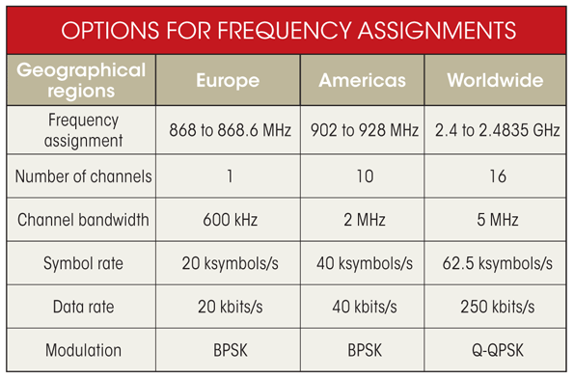

Slide 5
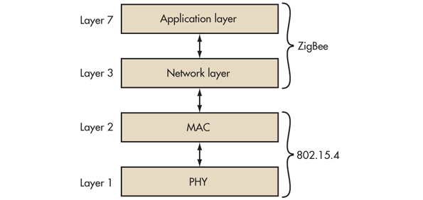

Slide 6
Zigbee technology
Zigbee communication is specially built for control and sensor networks on IEEE 802.15.4 standard for wireless personal area networks (WPANs), and it is the product from Zigbee alliance.
This communication standard defines physical and Media Access Control (MAC) layers to handle many devices at low-data rates.
These Zigbee’s WPANs operate at 868 MHz, 902-928MHz and 2.4 GHz frequencies.
The date rate of 250 kbps is best suited for periodic as well as intermediate two way transmission of data between sensors and controllers.

Slide 7
Zigbee
Used to create personal area networks with small, low-power digital radios, such as for home automation, medical device data collection, and other low-power low-bandwidth needs
Zigbee is low-cost and low-powered mesh network widely deployed for controlling and monitoring applications where it covers 10-100 meters within the range.
This communication system is less expensive and simpler than the other proprietary short-range wireless sensor networks as Bluetooth and Wi-Fi.
Zigbee supports different network configurations for master to master or master to slave communications.
Zigbee networks are extendable with the use of routers and allow many nodes to interconnect with each other for building a wider area network.

Slide 8
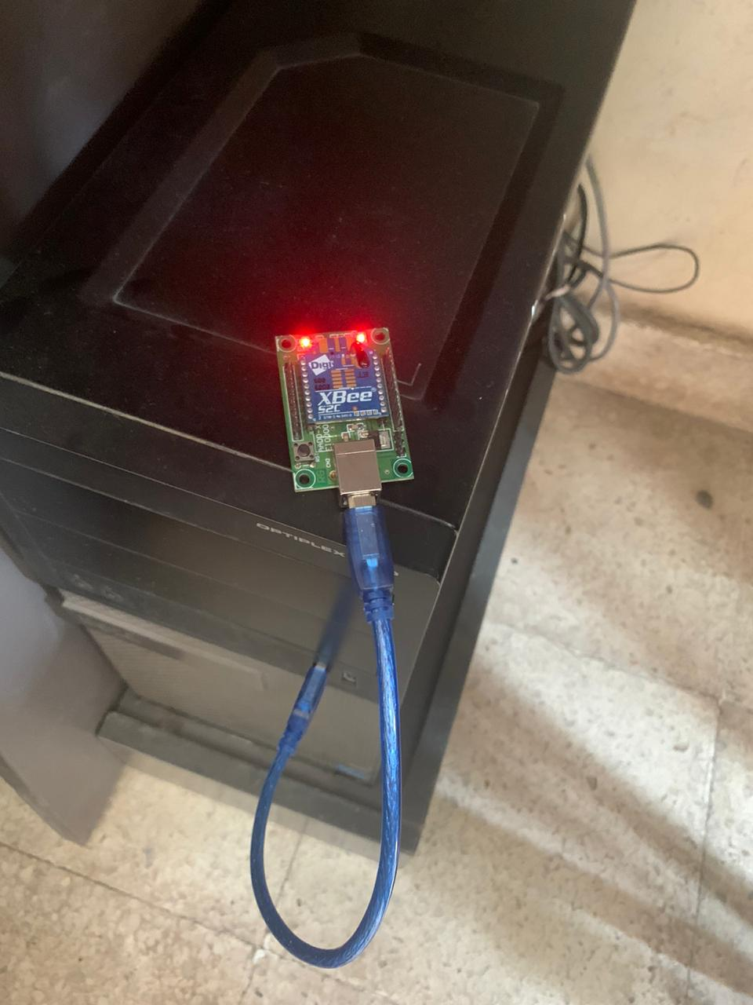
End Device 1
End Device 2

Slide 9
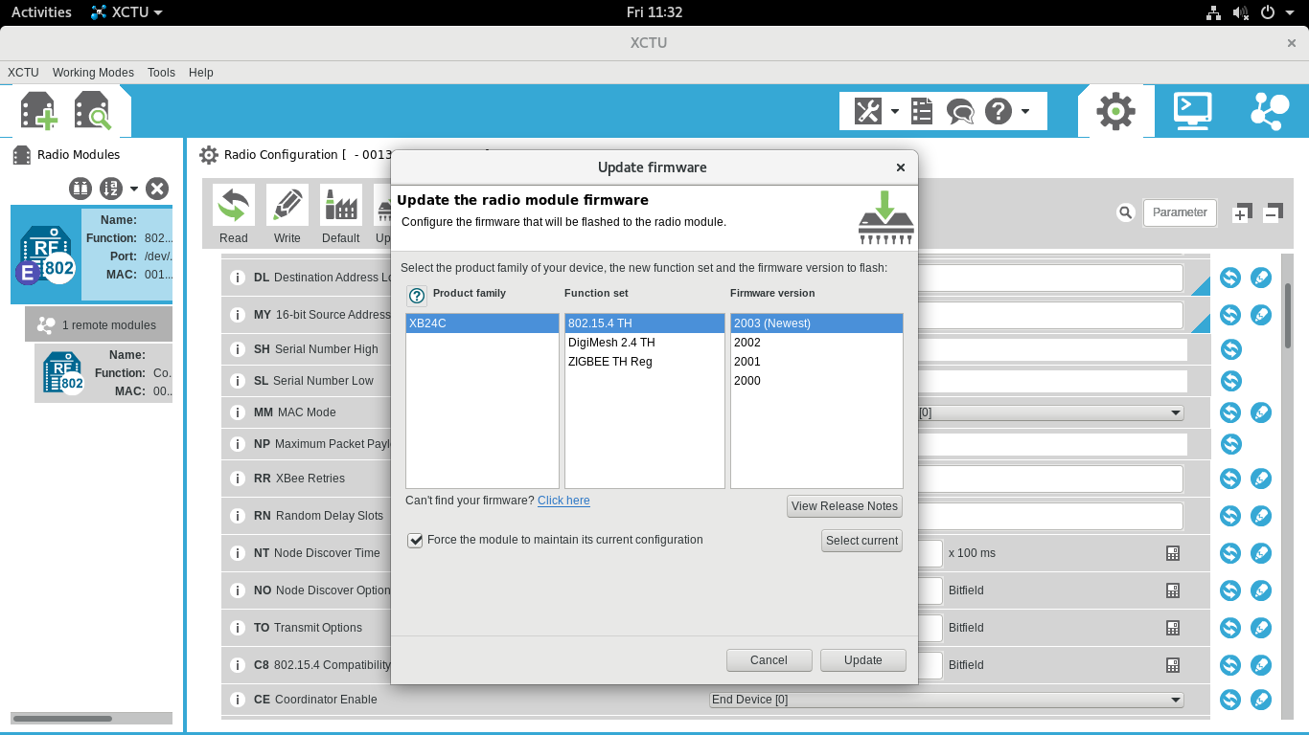

Slide 10
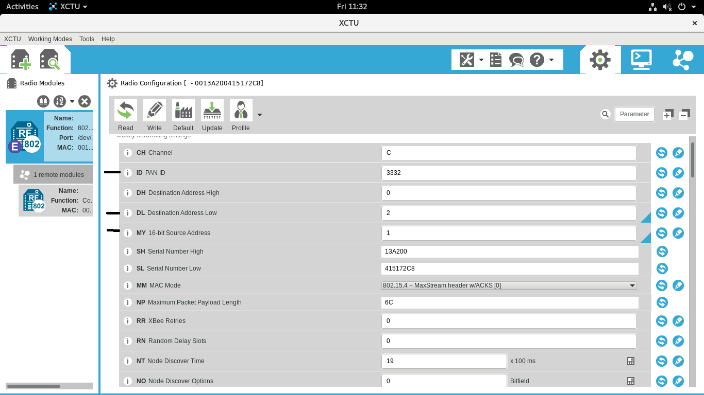

Slide 11
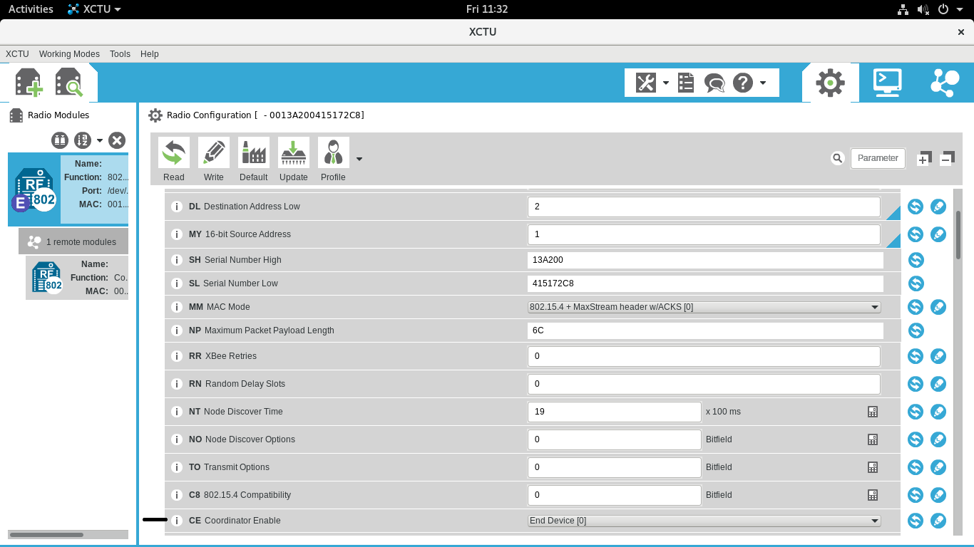

Slide 12
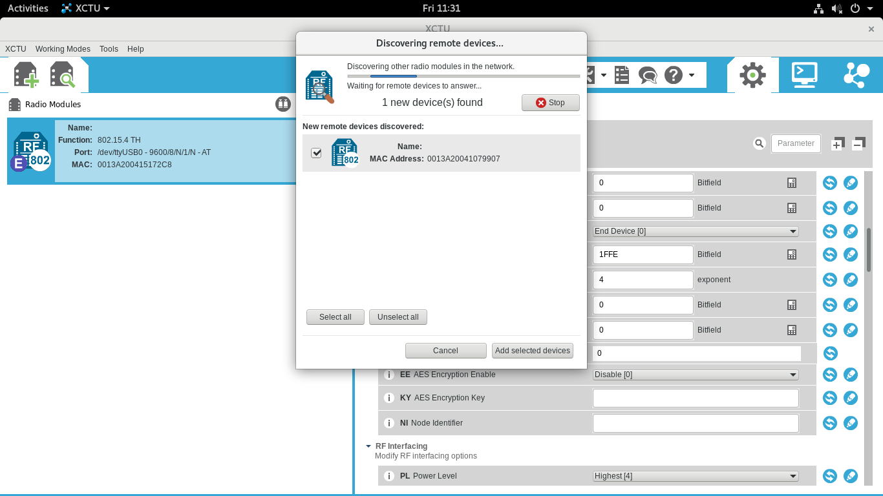

Slide 14
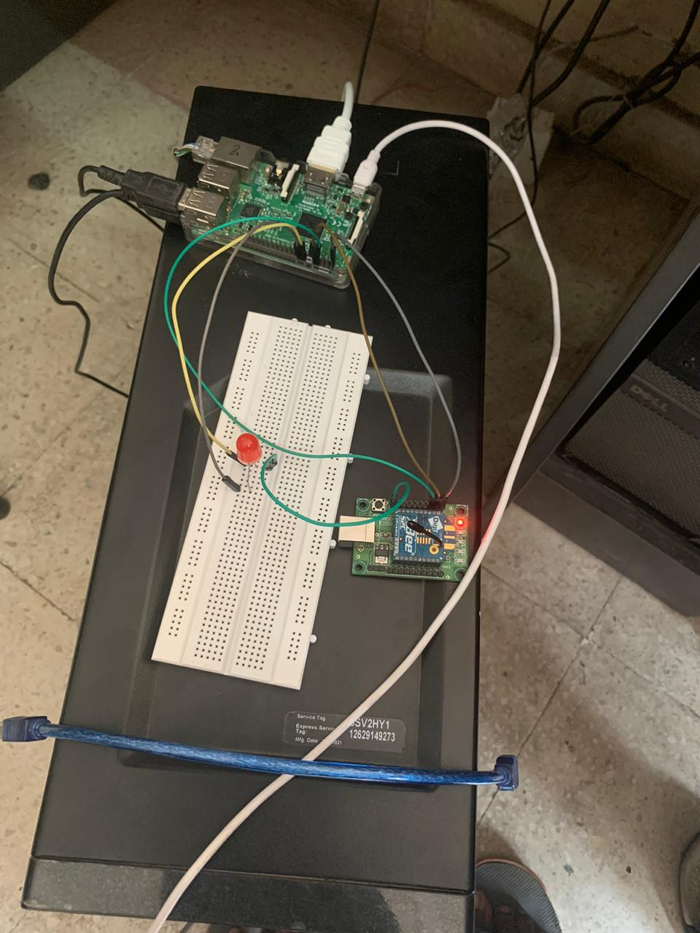
End Device 1
End Device 2

Slide 15
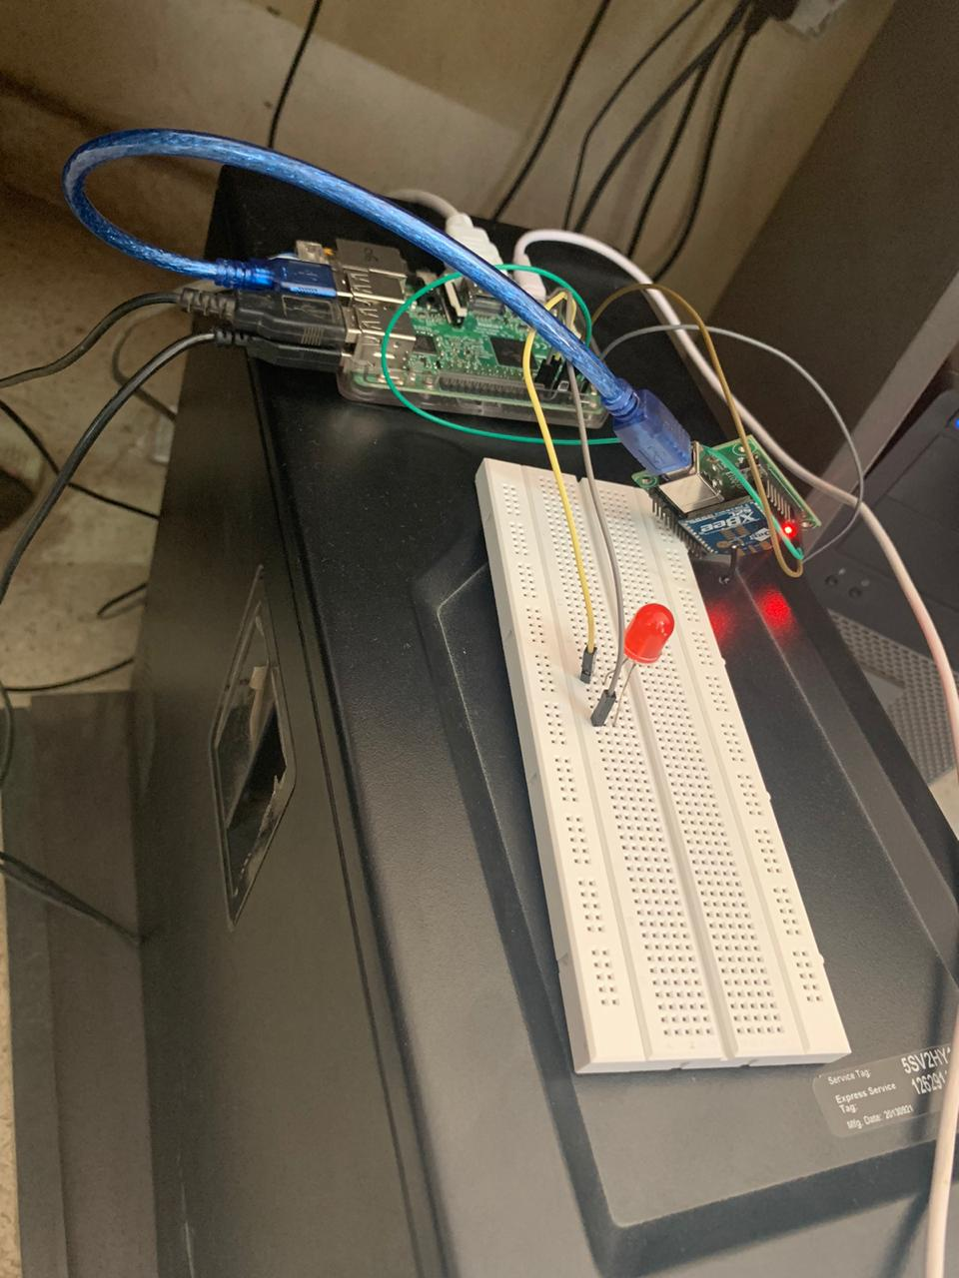
End Device 1
End Device 2

Slide 16
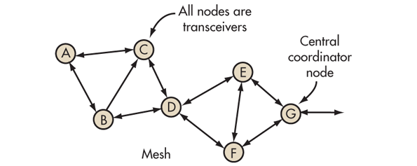

Slide 17
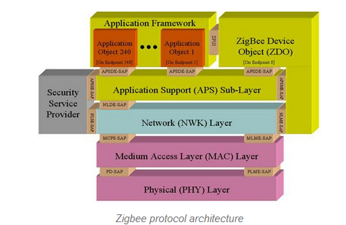
Zigbee Architecture

Slide 18
Zigbee Architecture
Divided into three sections
• IEEE 802.15.4 which consists of MAC and physical layers
• ZigBee layers, which consist of the network layer, the ZigBee device object (ZDO), the application sublayer, and security management
• Manufacturer application: Manufacturers of ZigBee
devices can use the ZigBee application profile or develop
their own application profile

Slide 19
Network Layer
Located between the MAC layer and application
support sublayer
• Provides the following functions:
- Starting a network
- Managing end devices joining or leaving a network
- Route discovery
Neighbor discovery
This layer takes care of all network related operations such as network setup, end device connection and disconnection to network, routing, device configurations, etc.

Slide 20
APS Layer
• Application Support Sublayer (APS)
• Provides services necessary for application objects
(endpoints) and the ZigBee device object (ZDO)
• Some of services provided by the APS to the application objects for data transfer are
• Request
• Confirm
• Response
* to interface with
the network layers for
data managing services.

Slide 21
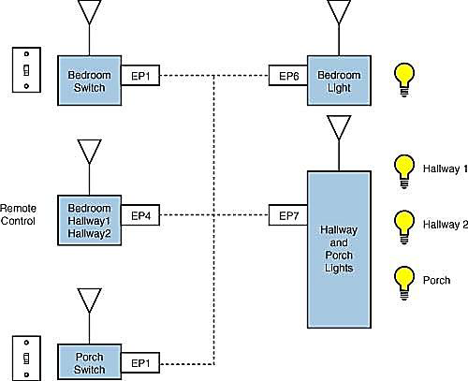
Application framework
Application Object
(endpoint [device instance])
• Defines input and output
to the APS
• For example, a switch
that controls a light is the
input from the
application object, and
the output is the light
bulb condition
• Each node can have 240
separate application
objects

Slide 22
• ZigBee Device Object (ZDO)
* Control and management of application objects
(end points)
* Performs overall device management tasks:
- Determines the type of device in a network
(for example, end device, router, or coordinator)
- Initializes the APS, network layer, and security service provider
- Performs device and service discovery
- Initializes coordinator for establishing a network
- Security management
- Network management
Zigbee Device Object (ZDO) provides
an interface between application objects
and APS layer in Zigbee devices.
It is responsible for detecting, initiating
and binding other devices to the network.

Slide 23
End Node
- Each end node or end device can have multiple Eps
- Each EP contains an application profile, such as home automation
can be used to control multiple devices or single device
• ZigBee Addressing Mode
ZigBee uses direct, group, and broadcast addressing for
transmission of information

Slide 24
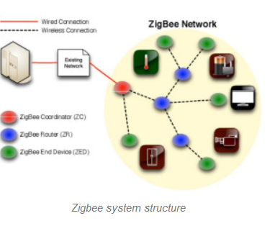
Zigbee system structure
For more details refer: https://www.elprocus.com/what-is-zigbee-technology-architecture-and-its-applications/

Slide 25
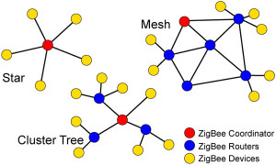
Zigbee Topologies
In a star topology, the network consists of one coordinator which is responsible for initiating and managing the devices over the network. All other devices are called end devices that directly communicate with coordinator. This is used in industries where all the end point devices are needed to communicate with the central controller,

Slide 26
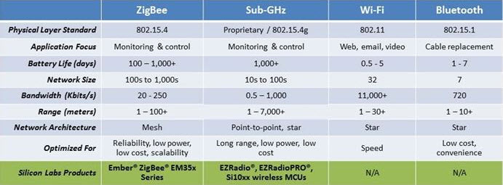

Slide 27
Some of these applications include:
• Building automation for commercial monitoring and control of facilities
• Remote control (RF4CE or RF for consumer electronics)
• Smart energy for home energy monitoring
• Health care for medical and fitness monitoring
• Home automation for control of smart homes
• Input devices for keyboards, mice, touch pads, wands, etc.
• Light Link for control of LED lighting
• Retail services for shopping related uses
• Network services related to large mesh networks

